Slide 1
Problem solving with sequences
Sequences

Slide 2
how to use Oak lessons

Slide 3
I can use my knowledge of sequences to solve problems.

Slide 4
An arithmetic (or linear) sequence is a sequence where the difference between successive terms is a constant.
Example: 5, 9, 13, 17, … is arithmetic. Constant difference +4
1, 2, 4, 8, … is not arithmetic. Not a constant difference.
The n^{th} term of a sequence is the position of a term in a sequence where n stands for the term number.
n = 10 means the 10th term in the sequence.
The n^{th} term can be used to calculate any term in a sequence so is also a formula for finding any term.

Slide 5

Problem solving with sequences
Generalising from non-sequential terms
Fractional sequences
Pattern spotting

Slide 6
Generalising from non-sequential terms
Find the missing terms in these arithmetic sequences.
Why are the second and third sequences harder?
13, 20, 27, 34, 41, …
We don’t have consecutive terms.
+7
+7
+7
+7
13, 18, 23, 28, 33, …
Two steps to make 10
+5
+5
+5
+5
13, 16, 19, 22, 25, …
Three steps to make 9
+3
+3
+3
+3

Slide 7
Generalising from non-sequential terms
Find the missing terms in these arithmetic sequences.
22.5, 20, 17.5, 15, 12.5, …
Two steps to make −5
−2.5
−2.5
−2.5
−2.5
1.2, 1.45, 1.7, 1.95, 2.2, …
Four steps to make 1
+0.25
+0.25
+0.25
+0.25

Slide 8
Generalising from non-sequential terms
We’ll see problems like this in a real-life context.
Buses depart Croydon for Lewisham at regular intervals. The third bus of the day left at 6:56 am, the sixth bus is leaving at 8:08 am
What time did the first bus leave?
6:08 am, 6:32 am, 6:56 am, 7:20 am, 7:44 am, 8:08 am …
+24
+24
+24
+24
+24
Three steps to make 72 minutes.
72 ÷ 3 = 24 minutes between buses.

Slide 9

Generalising from non-sequential terms
The 3rd bus of the day from Lewisham to Greenwich left at 6:50 am, the 5th bus left at 7:40 am. Which is true?
Buses leave every 50 minutes.
50 minutes from 6:50 am and 7:40 am.
Bus four would be in the middle of that gap.
50 ÷ 2 = 25
Buses leave every 45 minutes.
Buses leave every 25 minutes.

Slide 10
Generalising from non-sequential terms
How many steps are there between the 71st and the 95th terms in an arithmetic sequence?
25
24
From n = 71 to n = 95 there are 95 − 71 steps.
23

Slide 11
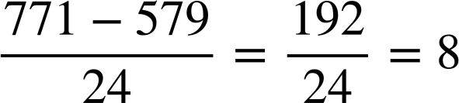

Generalising from non-sequential terms
The 71st term of an arithmetic sequence is 579 and the 95th term is 771. Find the n^{th} term of the sequence.
From n = 71 to n = 95 there are 95 − 71 = 24 steps.
It’s an 8n sequence.
Term number (n) | 71
8n | 568
8n + ____ | 579
Translation of +11 therefore,
8n + 11
+11

Slide 12
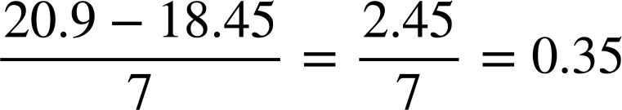
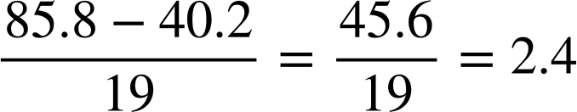
Generalising from non-sequential terms
The 25th term of an arithmetic sequence is 18.45 and the 32nd term is 20.9. Find the n^{th} term.
The 18th term of an arithmetic sequence is 40.2 and the 37th term is 85.8. Find the n^{th} term.
32 - 25 = 7 steps
37 - 18 = 19 steps
Term number (n) | 25
0.35n | 8.75
0.35n + 9.7 | 18.45
Term number (n) | 18
2.4n | 43.2
2.4n − 3 | 40.2
Term number (n) | 18
2.4n | 43.2
 | 40.2
+9.7

Slide 13
Generalising from non-sequential terms
1) Fill in the missing terms in these arithmetic sequences.
Term number (n) | 1 | 2 | 3 | 4 | 5 | 6
a) |  |  |  | 1 | 10
b) |  | 1 |  |  | 10
c) |  | 1 |  | 10
d) | 10 |  |  |  | 1

Slide 14
Generalising from non-sequential terms
2) Buses leave Chorley for Bolton at regular intervals. The second bus of the day left at 6:35 am. The sixth bus left at 8:03 am and you just missed it. What time is the next bus?

Slide 15
Generalising from non-sequential terms
3) The 23rd term of an arithmetic sequence is 187 and the 45th term is 363.
a) Find the 100th term of the sequence.
b) Will 3634 be a term in this sequence?

Slide 16
Generalising from non-sequential terms
1) Fill in the missing terms in these arithmetic sequences.
Term number (n) | 1 | 2 | 3 | 4 | 5 | 6
a) | −26 | −17 | −8 | 1 | 10 | 19
b) | −2 | 1 | 4 | 7 | 10 | 13
c) | −3.5 | 1 | 5.5 | 10 | 14.5 | 19
d) | 10 | 7.75 | 5.5 | 3.25 | 1 | −1.25
Term-to-
term rule
+9
+3
+4.5
−2.25

Slide 17
Generalising from non-sequential terms
2) Buses leave Chorley for Bolton at regular intervals. The second bus of the day left at 6:35 am. The sixth bus left at 8:03 am and you just missed it. What time is the next bus?
6:13 am, 6:35 am, 6:57 am, 7:19 am, 7:41am, 8:03 am, 8:25 am …
+22
+22
+22
+22
+22
4 steps to make 88 minutes
The buses are 22 minutes apart so the next one is 8:25 am

Slide 18
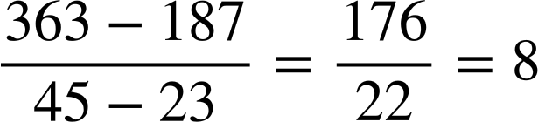
Generalising from non-sequential terms
3) The 23rd term of an arithmetic sequence is 187 and the 45th term is 363.
a) Find the 100th term.
Term number (n) | 23
8n | 184
8n + 3 | 187
Term number (n) | 23
8n | 184
 | 187
+3
When n = 100 the term value is 8(100)+3 = 803
b) Will 3634 be a term in this sequence?
No. We have odd terms and an even common difference therefore 3634, an even number, will not be in the sequence.

Slide 19
Problem solving with sequences
Generalising from non-sequential terms
Fractional sequences
Pattern spotting

Slide 20
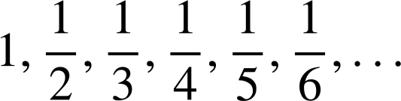


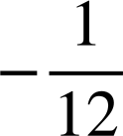
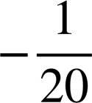
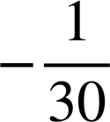
Fractional sequences
Is this an arithmetic sequence?
No common difference therefore not arithmetic. But, there is a pattern!

Slide 21







Fractional sequences
How do we define the pattern?
Term number (n) | 1 | 2 | 3 | 4 | 5 | 6 | n
Term value (T)
The numerator is constant but, there is clearly a relationship between the term number (n) and the denominator.
The sequence may not be arithmetic, but we were able to define an n^{th} term,

Slide 22
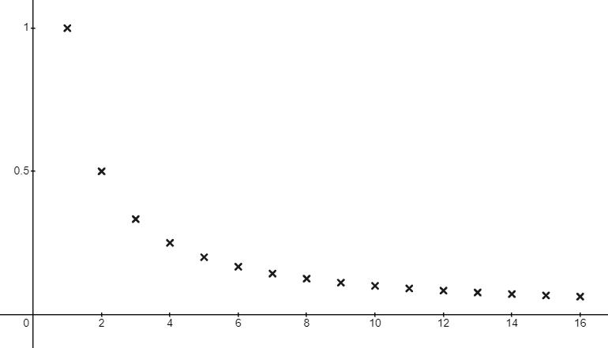
Fractional sequences
If it’s not arithmetic (linear), what would this sequence look like?
What an interesting graph!
Have you ever seen a graph like this before?

Slide 23
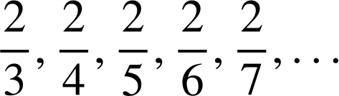
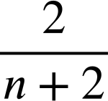
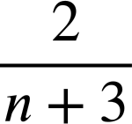
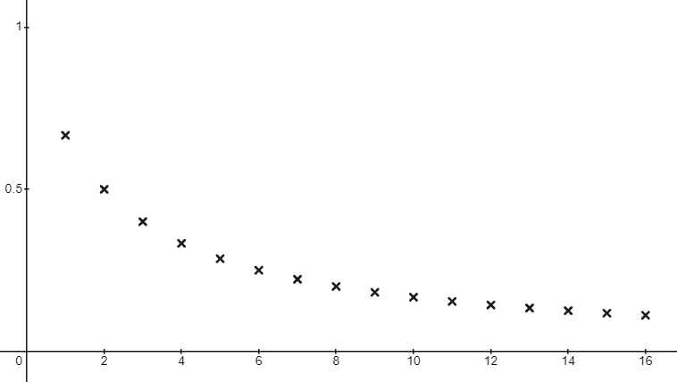

Fractional sequences
What is the n^{th} term for this non-arithmetic sequence?
The numerator is a constant, 2.
The denominator is the sequence n + 2, a translation +2 from the sequence n.
Another beautiful sequence!

Slide 24
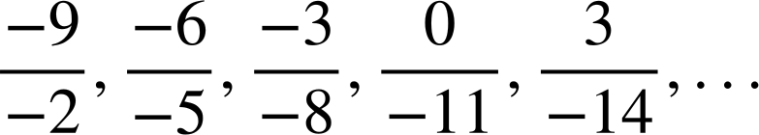
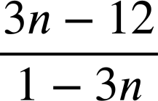
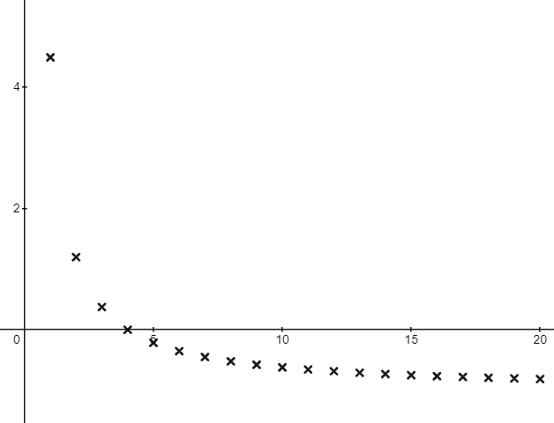
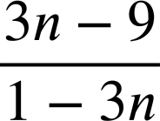
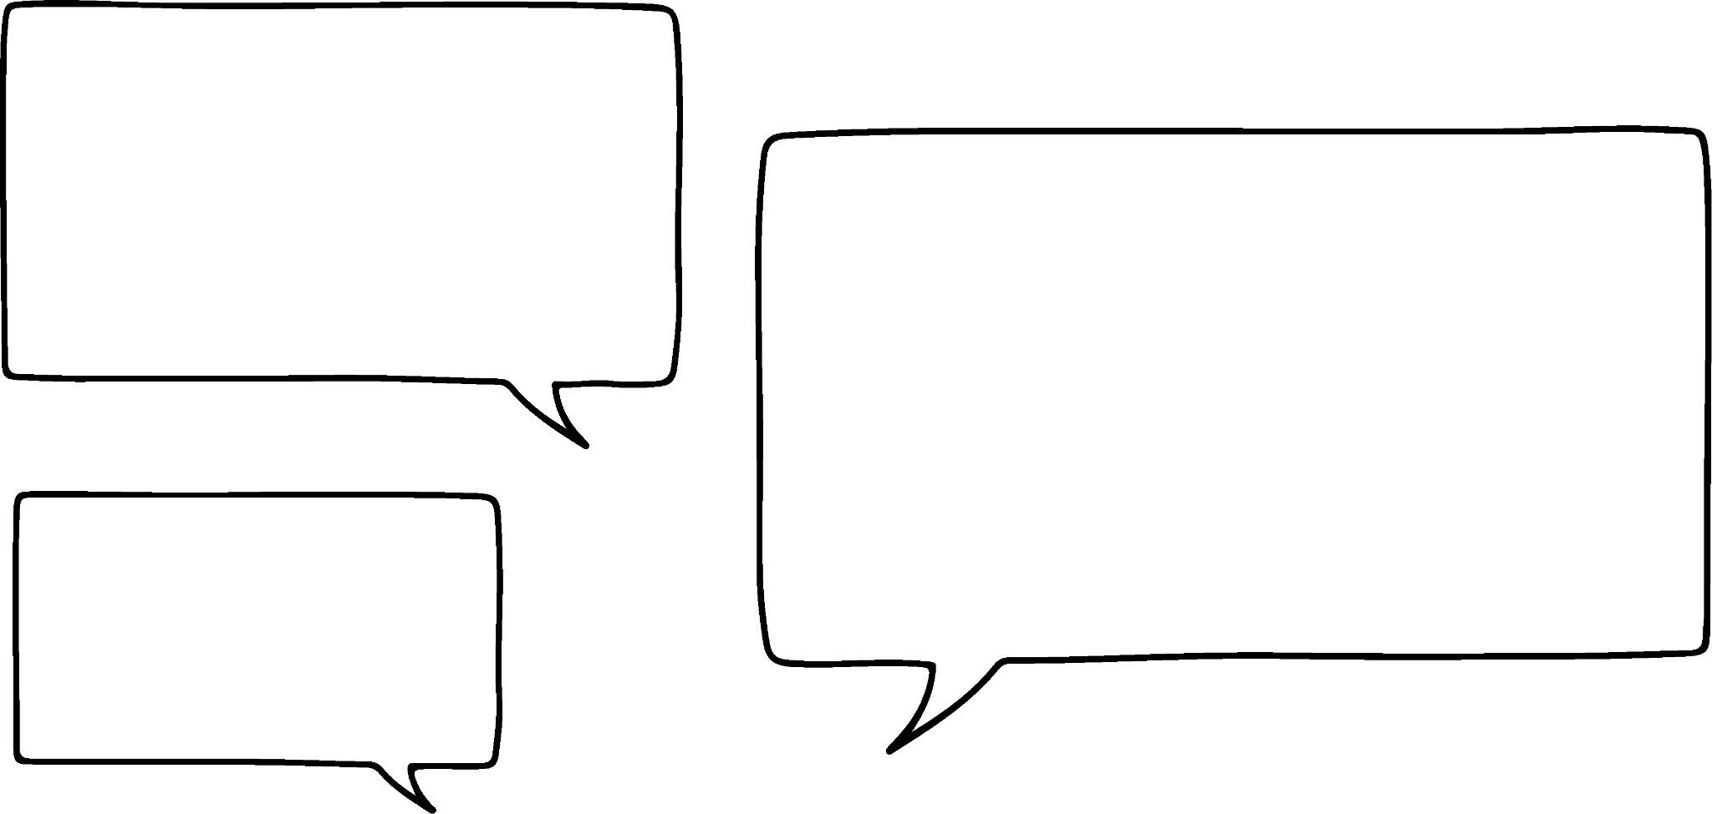
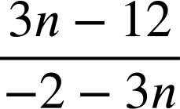
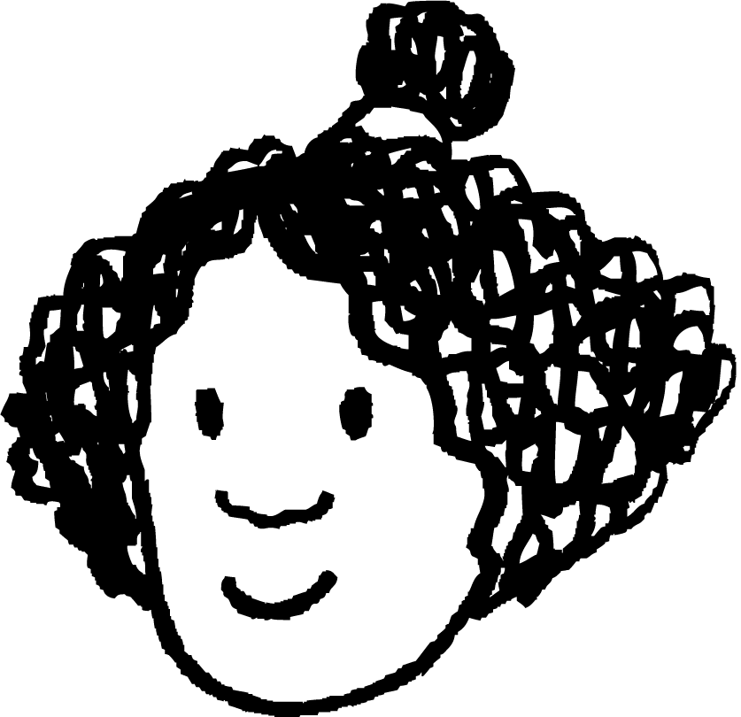
Fractional sequences
What is the n^{th} term for this non-arithmetic sequence?
The numerator is 3n − 12: −9, −6, −3, 0, 3, …
The denominator is 1 − 3n: −2, −5, −8, −11, −14, …
I’ve never seen a graph like this before!

Slide 25
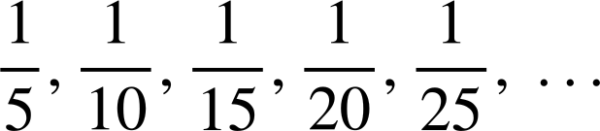


Fractional sequences
1) Jun and Laura are looking at a sequence.
5, 10, 15, 20, 25, …
This is an increasing sequence.
5, 10, 15, 20, 25, … That’s 5n.
This is an arithmetic sequence.
a) Justify why Jun is wrong.
b) Justify why Laura is wrong.

Slide 26
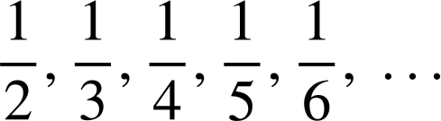
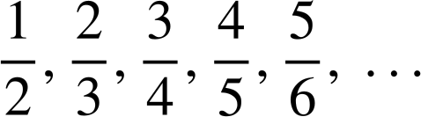
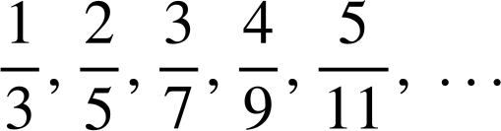
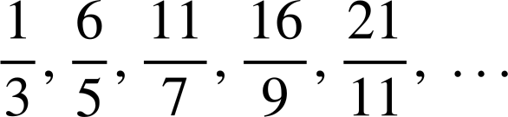
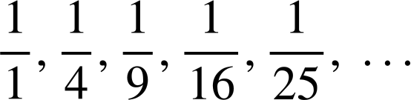
Fractional sequences
2) Write an n^{th} term for these fractional sequences.
a)
b)
c)
d)
e)

Slide 27
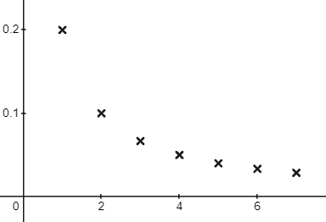
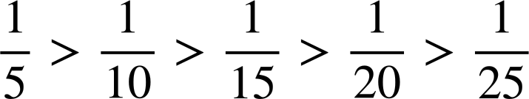
Fractional sequences
1) Jun and Laura are looking at a sequence.
You don’t need to graph sequences like this yet, but the graph shows this sequence is decreasing.
5, 10, 15, 20, 25, …
This is an increasing sequence.
a) Justify why Jun is wrong.
The sequence is decreasing.

Slide 28

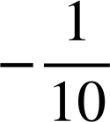
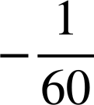
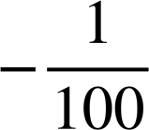
Fractional sequences
1) Jun and Laura are looking at a sequence.
But Laura has spotted something useful!
There is not a common difference so our sequence is not arithmetic.
5, 10, 15, 20, 25, … That’s 5n.
This is an arithmetic sequence.
b) Justify why Laura is wrong.

Slide 29
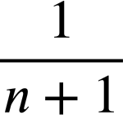
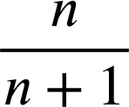
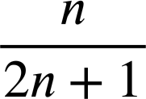
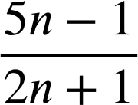

Fractional sequences
2) Write an n^{th} term for these fractional sequences.
a)
b)
c)
d)
e)
Constant numerator and non-arithmetic pattern in the denominators.

Slide 30
Problem solving with sequences
Generalising from non-sequential terms
Fractional sequences
Pattern spotting

Slide 31
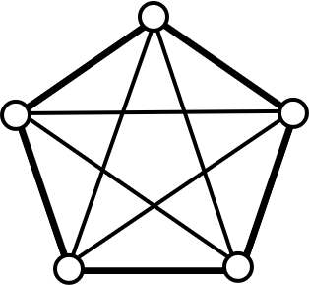
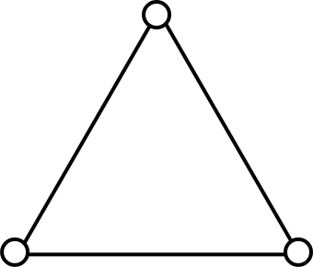
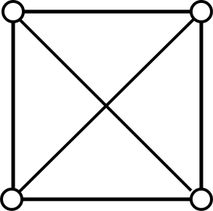
Pattern spotting
Fifteen people meet for the first time and shake hands
with each other just once. How many handshakes will occur?
Let’s draw diagrams and record the number of handshakes in a table
People | 1 | 2 | 3 | 4 | 5 | 6 | ...
Handshakes | 0 | 1 | 3 | 6 | 10

Slide 32

Pattern spotting
Fifteen people meet for the first time and shake hands
with each other just once. How many handshakes will occur?
People | 1 | 2 | 3 | 4 | 5 | 6 | ...
Handshakes | 0 | 1 | 3 | 6 | 10 | 15
I don’t need to draw the 6th one. I have spotted a pattern in the numbers.
+1
+2
+3
+4
+5
Can you see Aisha’s pattern?
Aisha
If you draw 6 out and test it you will find 15 to be correct.

Slide 33
Pattern spotting
Fifteen people meet for the first time and shake hands
with each other just once. How many handshakes will occur?
People | 1 | 2 | 3 | 4 | 5 | 6 | 7 | 8 | 9 | 10 | 11 | 12 | 13 | 14 | 15
Handshakes | 0 | 1 | 3 | 6 | 10 | 15 | 21 | 28 | 36 | 45 | 55 | 66 | 78 | 92 | 105
+1
+2
+3
+4
+5
There will be 105 handshakes.
1, 3, 6, 10, 15, … you might recognise as triangular numbers.

Slide 34
Pattern spotting
When faced with a complex problem, what useful approaches can be taken?
Try to visualise the problem.
Break it down into smaller steps.
Hypothesise and test the hypothesis.
Look for patterns.

Slide 35

Pattern spotting
1) How many squares are there on a chess board?
Don’t forget to consider all the squares!

Slide 36
Pattern spotting
1) How many squares are there on a chess board?
Break the problem down.
Square size | Frequency
8 × 8 | 1

Slide 37
Pattern spotting
1) How many squares are there on a chess board?
Break the problem down.
Square size | Frequency
8 × 8 | 1
7 × 7 | 4

Slide 38
Pattern spotting
1) How many squares are there on a chess board?
Break the problem down.
Square size | Frequency
8 × 8 | 1
7 × 7 | 4
6 × 6 | 9
5 × 5 | 16
Square numbers.
Spot a pattern.
If you draw and test 5 × 5 you’ll find 16 is correct.

Slide 39
Pattern spotting
1) How many squares are there on a chess board?
The sum of the first 8 squares, 204
Square size | Frequency
8 × 8 | 1
7 × 7 | 4
6 × 6 | 9
5 × 5 | 16
4 × 4 | 25
3 × 3 | 36
2 × 2 | 49
1 × 1 | 64

Slide 40
Problem solving with sequences
We can use our knowledge of sequences, such as pattern spotting and finding n^{th} terms, to solve problems.

Slide 41

© Oak National Academy 2023.
Produced in partnership with Mathematics in Education and Industry.
Licensed on the Open Government Licence v3.0, except where otherwise stated. See Oak terms and conditions.

